Slide 1



The Open Source Roadshow KCCITM
Getting started with
Git and GitHub
@loveneeshdhir
Loveneesh Dhir

Slide 2


Slide 3
Coding Blocks
Avail 55% off on online courses offered by Coding Blocks using coupon code CBTA0033

Slide 4


Before we start...
Git Installed
GitHub account Your favorite editor

Slide 5





Workshop Flow
My ﬁrst git: What is Git and GitHub?
git good: Git Fundamentals 101
git explore: Explore the GitHub Universe
open sourcing: Doing some good for the tech community

Slide 6

My First Repo!
What is Git and GitHub?

Slide 7

What is Git?
" The stupid content tracker “
"Global Information Tracker":
you're in a good mood, and it actually works for you. Angels sing, and a light suddenly ﬁlls the room.
"Goddamn Idiotic Truckload of sh*t": when it breaks

Slide 8

So, What is Git?
A Distributed Version Control System.
Any project which uses Git will have a .git folder which stores all the history of the project.

Slide 9



History:
Know exactly which ﬁles changed, who made those changes, and when those changes occured.
Backup:
Ability to have different versions of the code in different places.
Collaboration:
Collaborate easily with other people on the same project by uploading and receiving changes

Slide 10

What is GitHub?
GitHub is a website that allows us to use git and create repositories online. It can also store all your projects online for free.

Slide 11
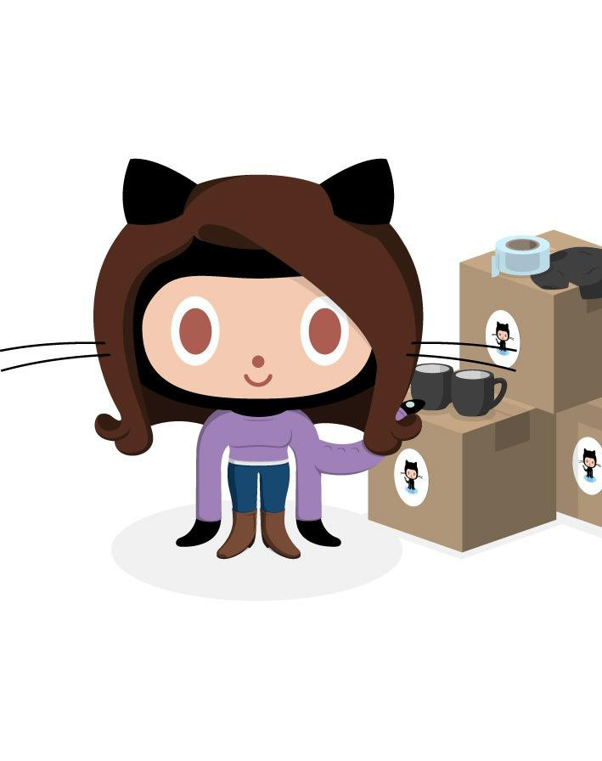
What is a repository?
A repository is a container that houses your project and its’ history. If your project folder contains the “.git” folder you’re working with a repository!

Slide 12




If you are on windows, open Git-Bash.
Let’s get started!
If you are on linux or Mac, ﬁre up a terminal.

Slide 13
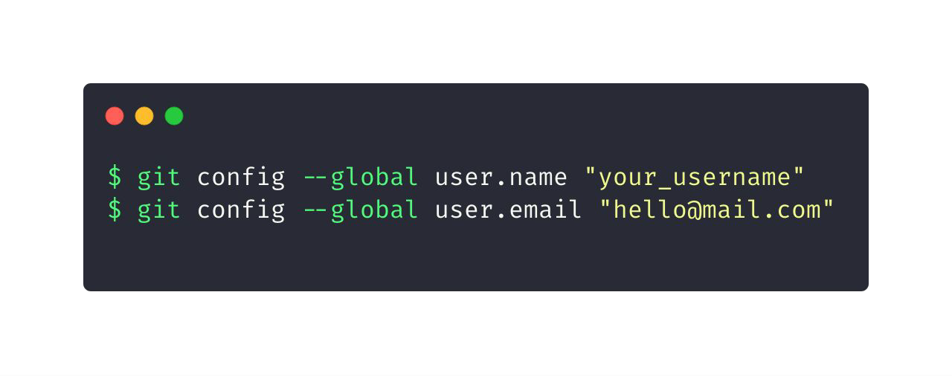
Let git know who you are
GitHub uses the email address set in your local Git conﬁguration to associate commits pushed from the command line with your GitHub account.

Slide 14
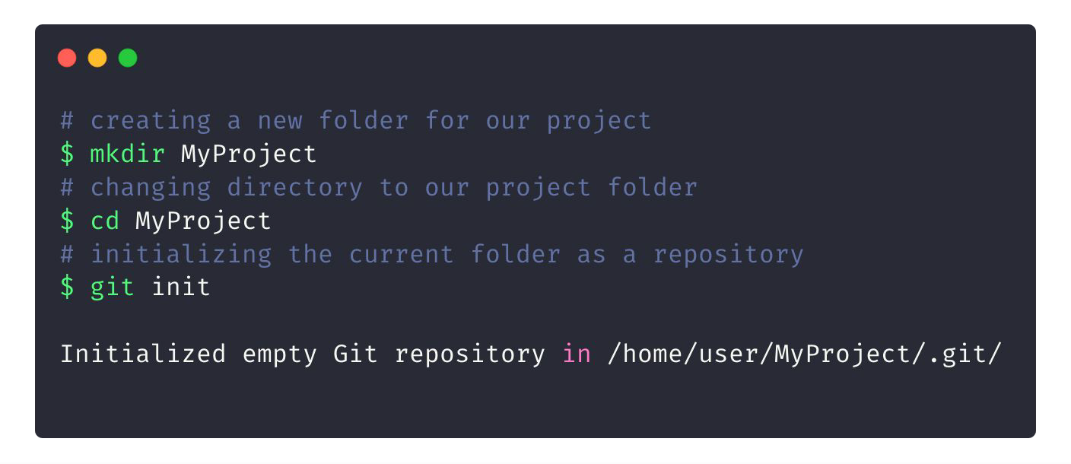
Initializing a new repository

Slide 15

Commits
Checkpoints/Snapshot of the state of your repository (project) at a particular time.

Slide 16
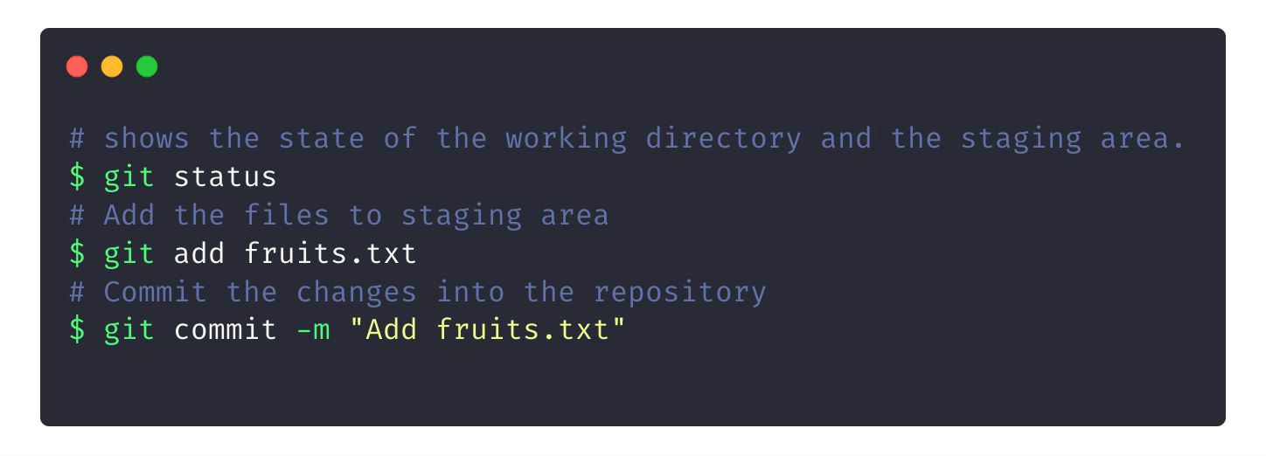
Creating your ﬁrst commit

Slide 17
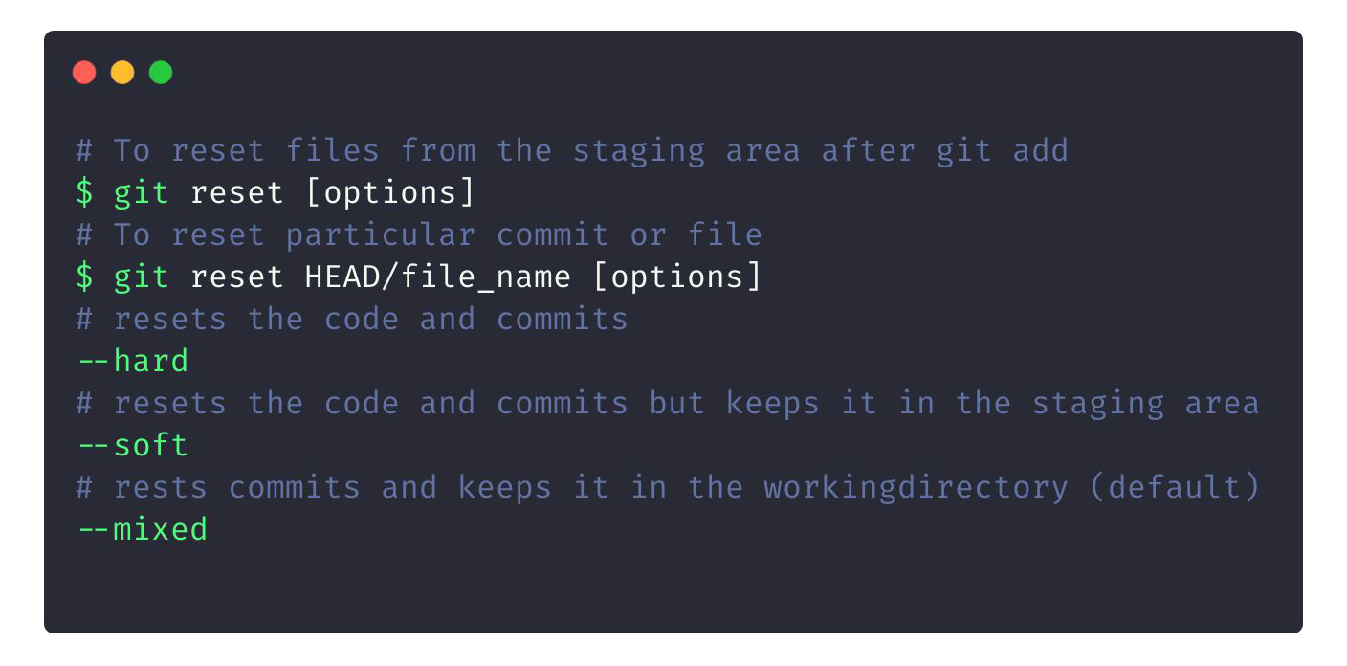
To Reset your Commits

Slide 18

Working with GitHub and fundamentals of Git 101.
Git Good!

Slide 19
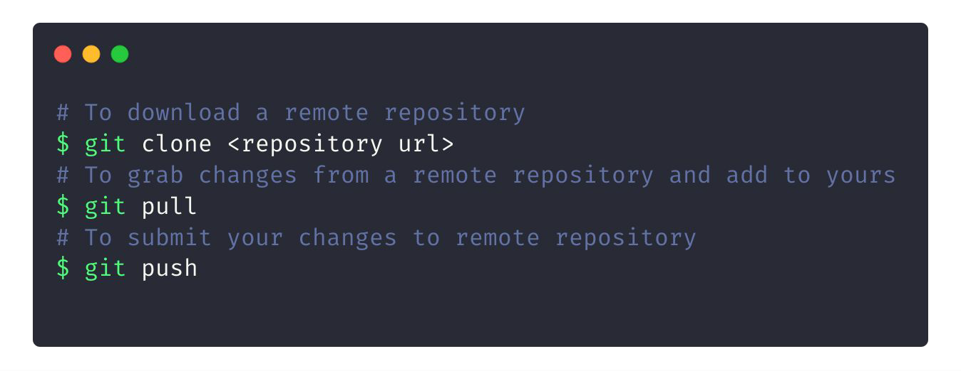
Downloading/Updating repos

Slide 20
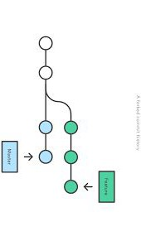
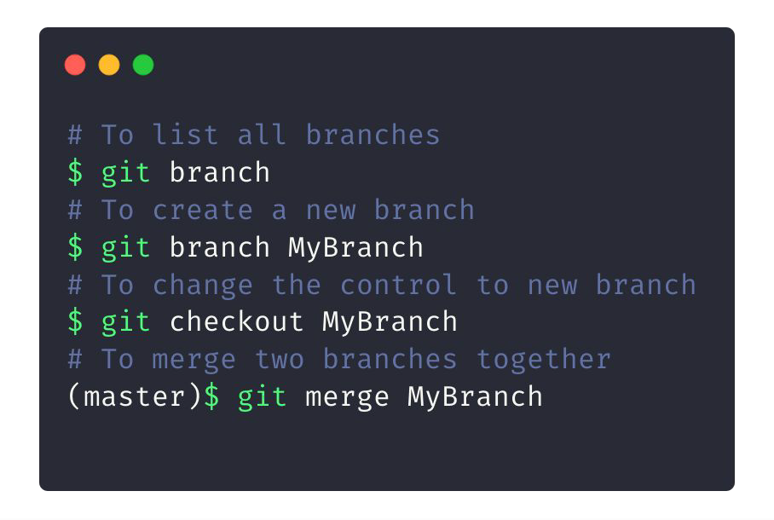
Git Branches

Slide 21
Time for some hands on!
https://tosr.netlify.com

Slide 22

What can we do with GitHub?
Well, what not?

Slide 23





Education
GitHub
Programs and technology leadership at your school
Campus Advisors

Slide 24



Events on GitHub

